Slide 1
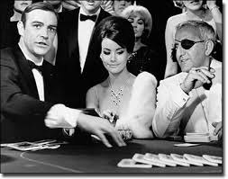
Baccarat
Project Manager: Emma Perez
Development Manager: David Hart
Application Architect: Michael Brooks
Quality Assurance Manager: Addison Kolbas

Slide 2
Rules
There are multiple ways to play Baccarat with different rules
We chose to implement three.
….

Slide 3
Tools
Slack
Google Drive
Trello
Scene Builder (Gluon) for Java FX
Eclipse

Slide 4
Language and Platform
Java/Java FX
Windows 7
Mac OS
Linux
Mostly a desktop application
Goal: also create mobile app

Slide 5
Agile Scrum
Trello: used for task management
Task assignments
Due dates
Goals
Story Board
For overall project tasks
Sprints
Current sprint: 2
Slack: for communication everyday

Slide 6
Architect

Slide 7
Developer
I will have code pulled up on my machine

Slide 8
Demo
Show game
Just going to run through my terminal

Slide 9
QA

